Slide 1






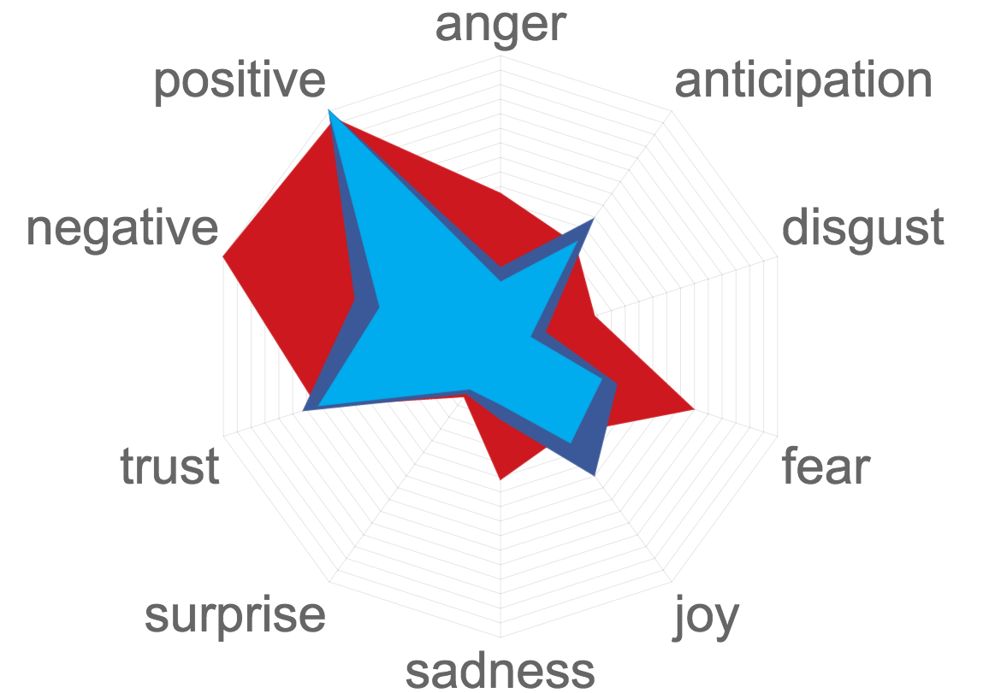
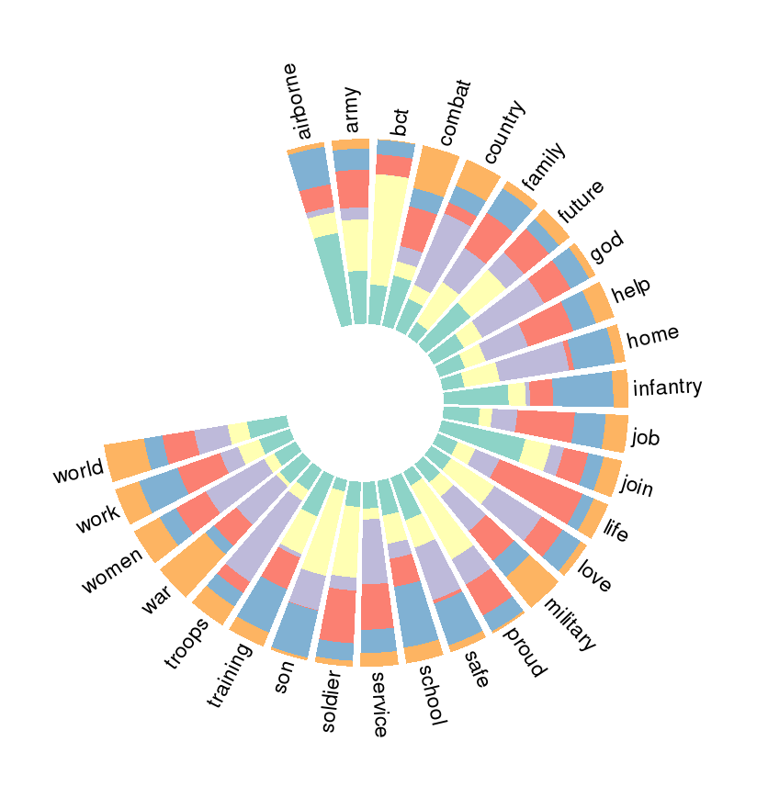
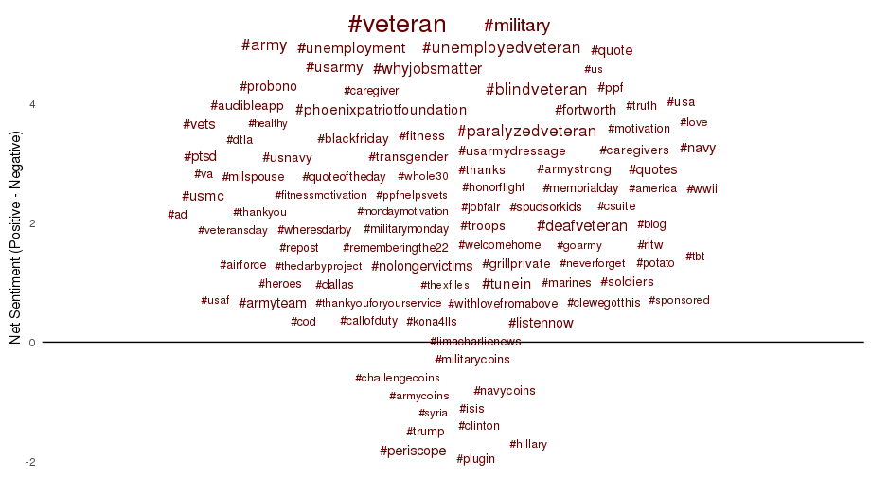
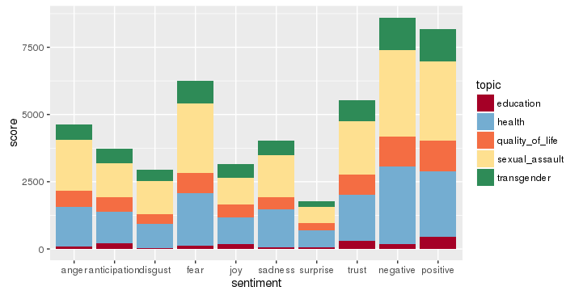

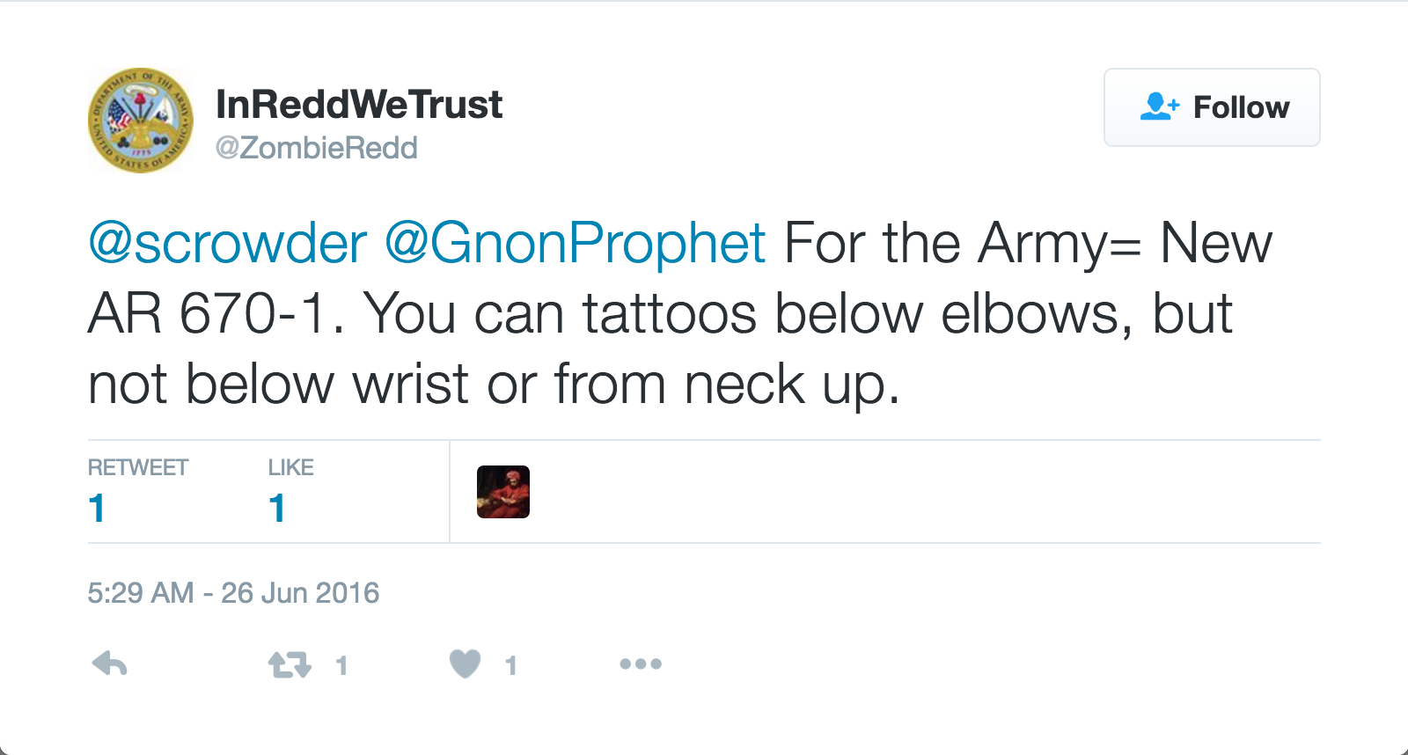
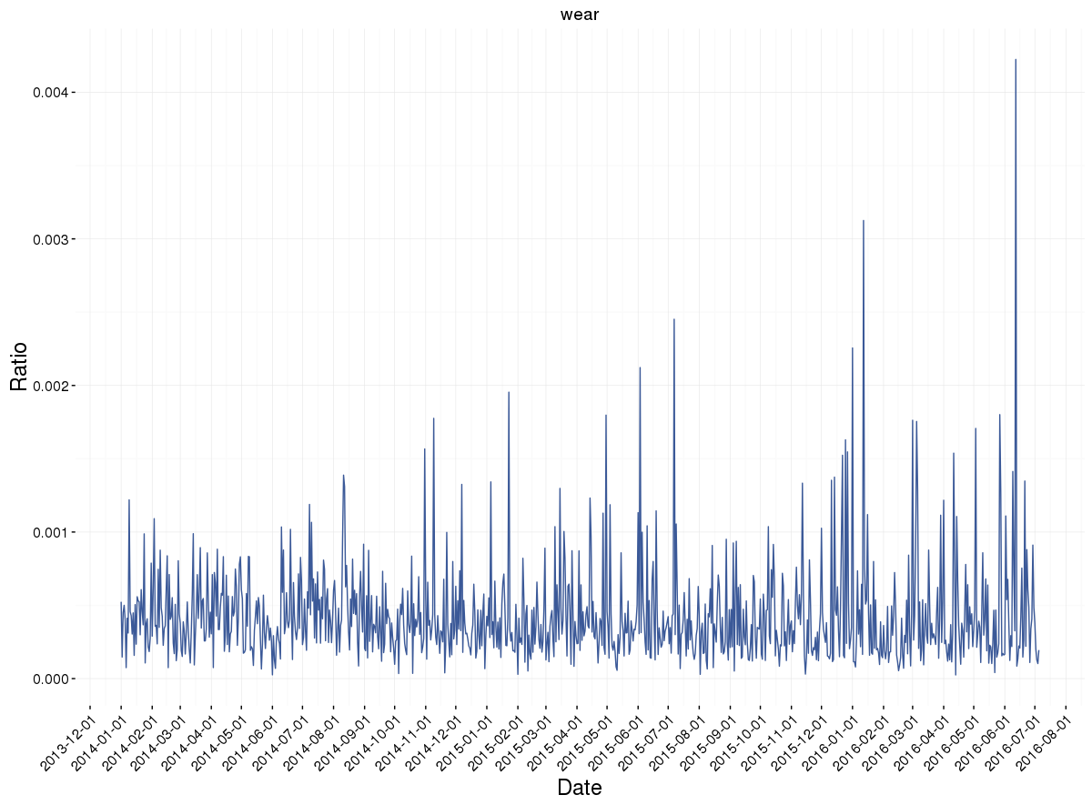
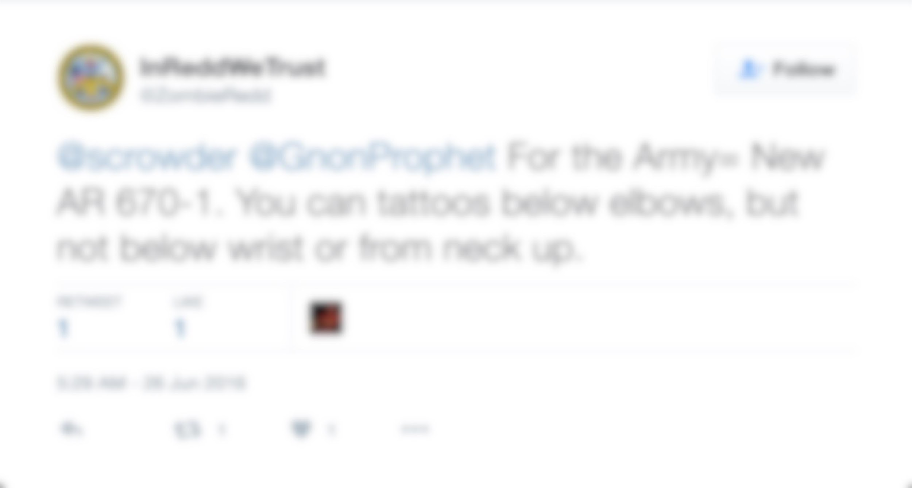
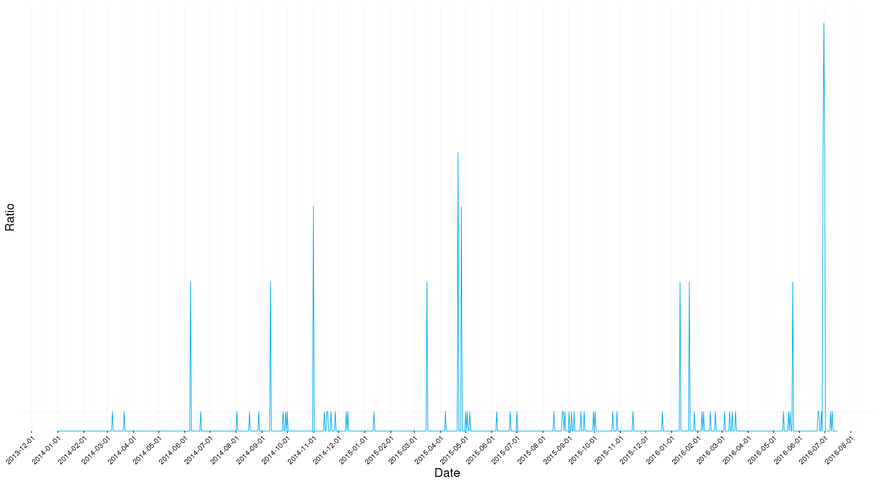
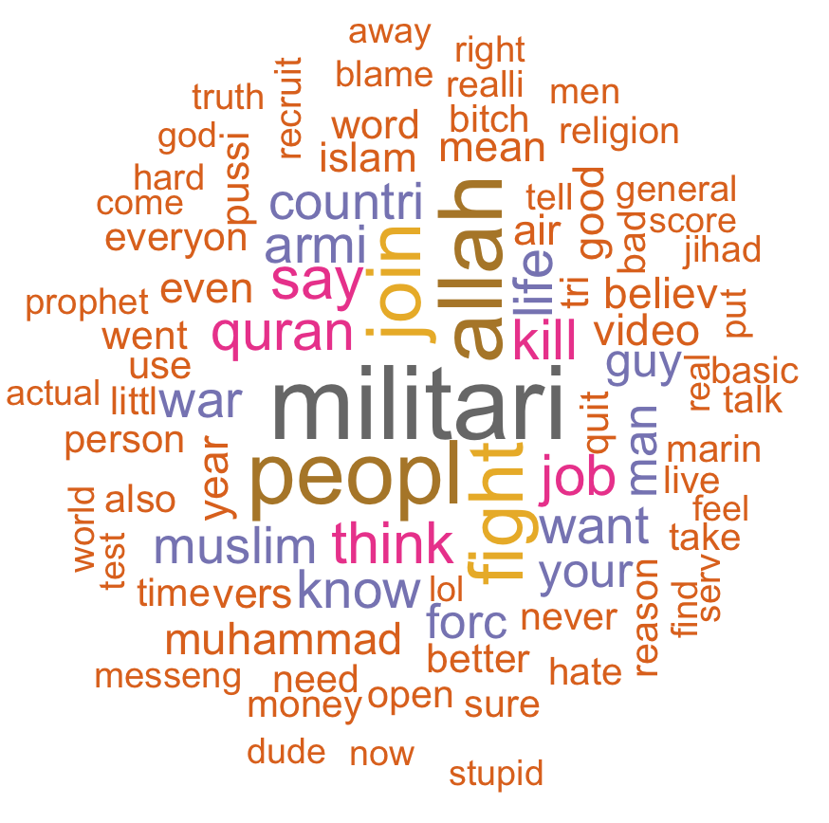
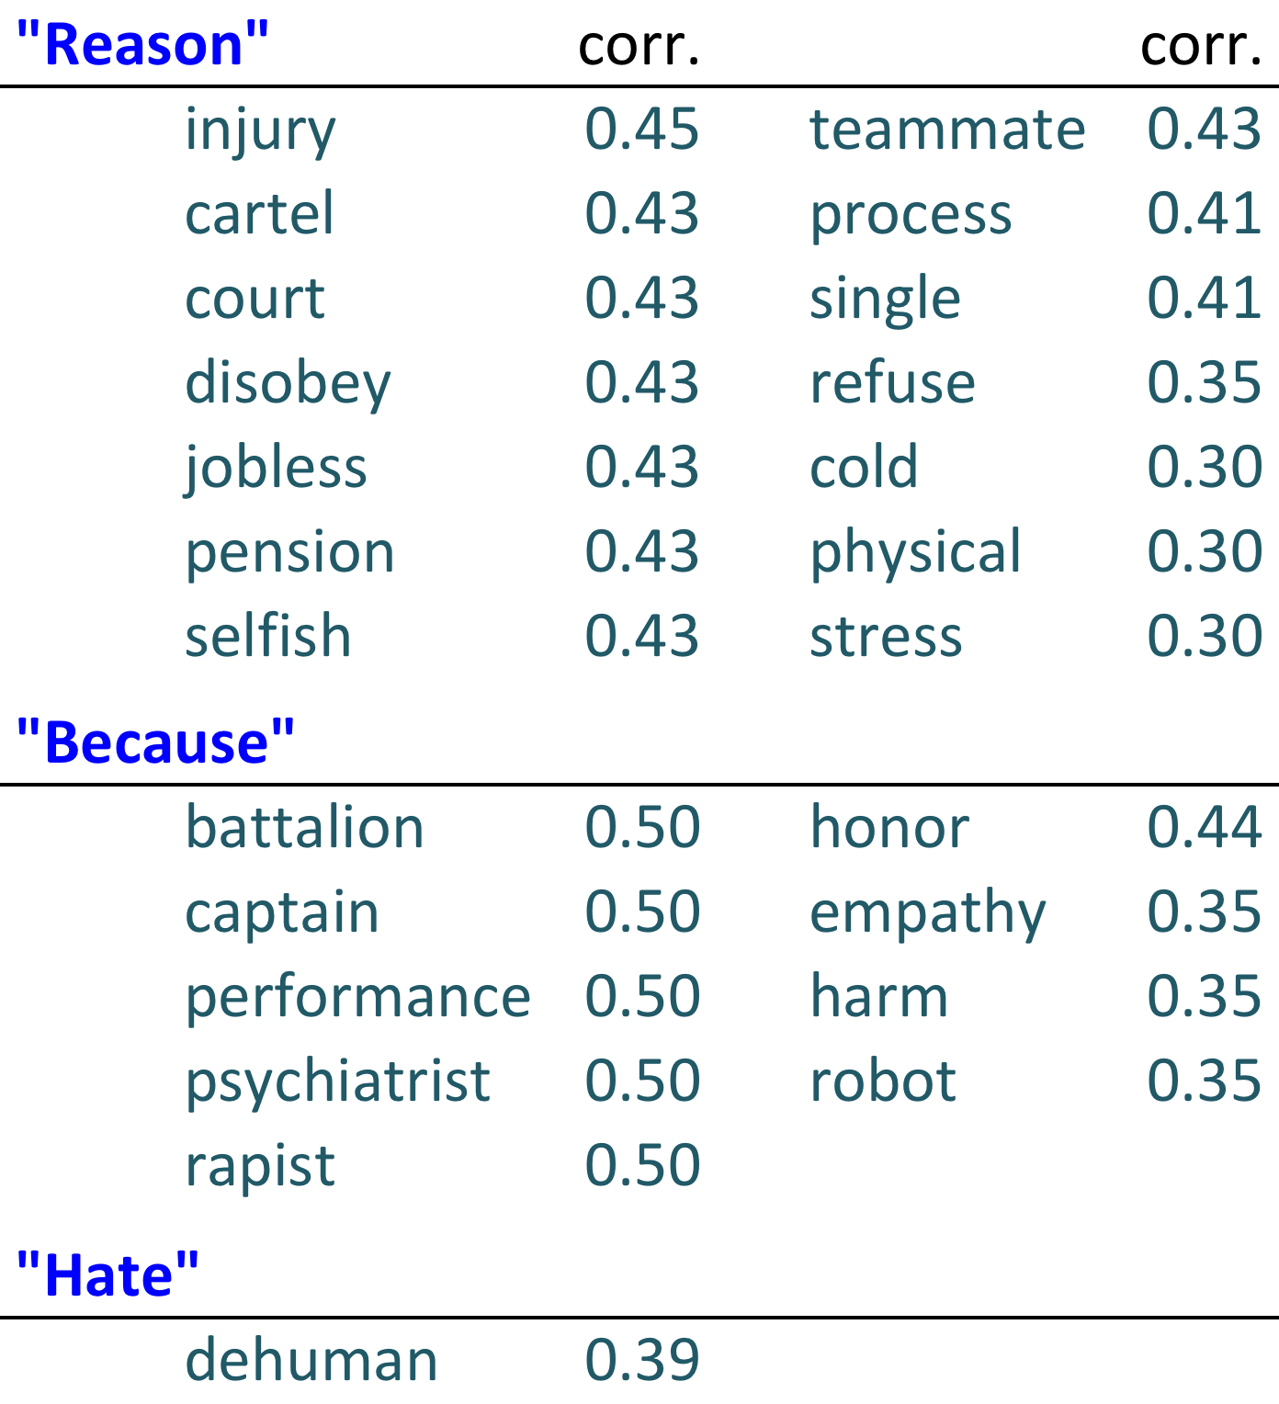
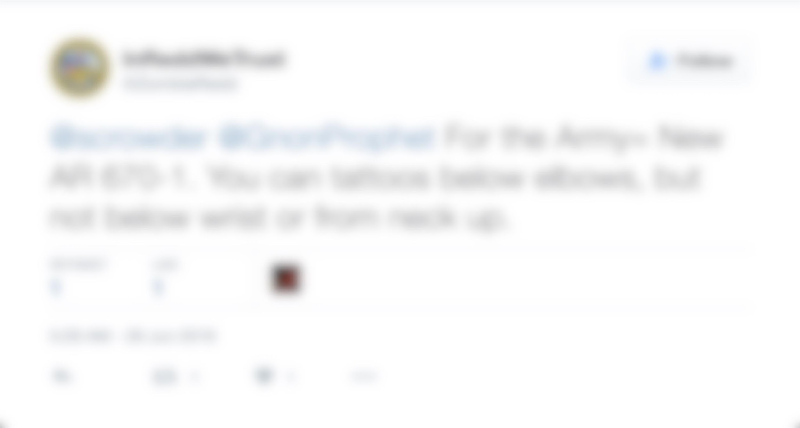
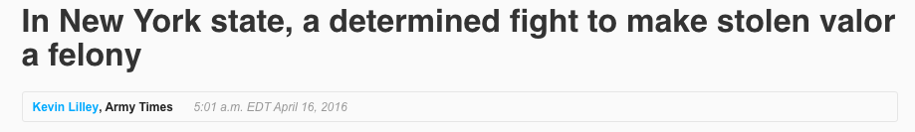
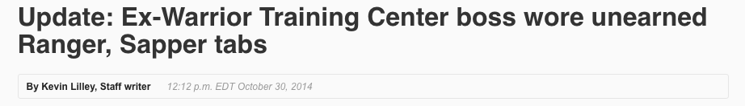


The Use of Social Media
by the Army population
Data Science for the Public Good
Mark Almanza (Virginia Tech), Millicent Grant (Iowa State University), Will Sandholtz (UC Berkeley)
with Gizem Korkmaz (SDAL) Sponsor: Gregory A. Ruark, U.S. Army Research Institute for the Behavioral and Social Sciences
Research Questions
Social media offers a new opportunity to capture Soldiers’ well-being and/or concerns about the Army. This exploratory study aims to understand the use of social media by the U.S. Army population. We use data from various social media platforms to address the following questions:
Are there differences in topics and sentiments across groups (e.g., Soldiers vs. family) and across social media venues?
Can we identify determinants of attrition and changes in policies through the chatter in social media?
Data & Methods
The study focuses on Facebook, Twitter, and YouTube as they are the most commonly used social media platforms. They provide users with a free application programming interface (API) that facilitates the collection of the data.
Sentiment Comparisons
For each social media platform, the overall sentiment is calculated.^{[4]}
Facebook Data^{[1]}
34 Army/military related pages
Pages grouped in 6 categories: Army Bases, Official Army, Unofficial Army, Unofficial Military, Army Family, and Military Family
6,089,415 comments from 191,342 posts until July 5, 2016
Twitter Data^{[2]}
43,409 tweets from 1,296 users between 2014 to 2016
8,938 Army/military related hashtags
YouTube Data^{[3]}
68 videos on 10 different topics such as education (e.g., college, GI bill), health (e.g. suicide, PTSD), quality of life (e.g., life on base, mail, food), sexual assault of women, and transgender
9,791 comments from the videos
Facebook (dark blue) and Twitter (light blue) have strikingly similar sentiment.
The sentiments on YouTube (red) are more negative than either Facebook or Twitter.
This may be due to the increased anonymity afforded by YouTube.
Analysis
Topics by Group
#Hashtag Sentiments
Sentiments by Topic
To compare topics discussed across different groups, the fraction of word frequencies over the total number of words in the comments is calculated.
Analyzed the sentiments in the tweets that contain the 100 most frequent hashtags.^{[4]}
Sentiment analysis is used to compare sentiments about various topics.^{[4]}
Groups
Legend?
Official Army
Army Family
Military Family
Unofficial Army
Army Bases
Unofficial Military
The sentiments vary for each topic with the total sentiment being more negative.
Barring positivity and negativity, fear is the main sentiment expressed with respect to sexual assault and health.
Certain words are used much more frequently in particular groups of pages (e.g., “troops” most used on Military Family pages, “join” most used on Official Army pages).
Most hashtags are more positive than negative.
Tweets with #veteran tend to be the most positive, and tweets about the election tend to be the most negative.
“Why I Quit the Army”
Identifying Policy Changes Over Time
Identified 6 videos with titles related to Soldiers leaving the Army.
Analyzed the word frequencies and correlations between selected relevant words in the comments of these videos.
The daily frequency of each word from 2014 to present was counted.
The spikes relevant to specific policies introduced/changed during the same period were identified.
???
*Words with correlations above/equal to 0.30 are reported.
Words related to job, religion, war are used frequently.
Injury, pension, performance, stress are highly correlated with the words “reason”, “because”, “hate.”
References
The frequency of the word “WEAR” on Facebook and Twitter; the peaks correspond to the dates of uniform policies.
Pablo Barbera, Michael Piccirilli and Andrew Geisler (2016). Rfacebook: Access to Facebook API via R. R package version 0.6.3. https://CRAN.R-project.org/package=Rfacebook
Jeff Gentry (2015). twitteR: R Based Twitter Client. R package version 1.1.9. https://CRAN.R-project.org/package=twitteR
Timothy Graham & Robert Ackland and with contribution from Chung-hong Chan (2016). SocialMediaLab: Tools for Collecting Social Media Data and Generating Networks for Analysis. R package version 0.22.0. https://CRAN.R-project.org/package=SocialMediaLab
Jockers ML (2015). _Syuzhet: Extract Sentiment and Plot Arcs from Text_. <URL: https://github.com/mjockers/syuzhet>.
Acknowledgments
We thank Dr. Brian Goode (Research Scientist, Discovery Analytics Center, Virginia Tech) for guidance on access to the social media platforms.
We thank Madison Arnsbargar (Virginia Tech), Jessica Flynn (Cornell), Emily Stark (Austin Peay), and Kathryn Ziemer (SDAL) for helping us with identifying the relevant policy changes for the period of the study.
bi.vt.edu/sdal

